Slide 1


Project Title
Prepared By:-
Student 3 Name:Foram Mendha
Roll no:72
Enrollment No:22002171210076
Batch: B3 Branch:CSE
Student 1 Name:Pratham Dhanvade
Roll no:65
Enrollment No:22002171210020
Batch:B3 Branch:CST
Student 4 Name:Kalp Mehta
Roll no:81
Enrollment No:22002171210075
Batch: B3 Branch:CSE
Student 2 Name:Mihir Patel
Roll no:70
Enrollment No:22002171310088
Batch:B3 Branch:CST
Student 5 Name:Stavan Joshipura
Roll no:89
Enrollment No:22002171210047
Batch: B3 Branch:CSE

Slide 2
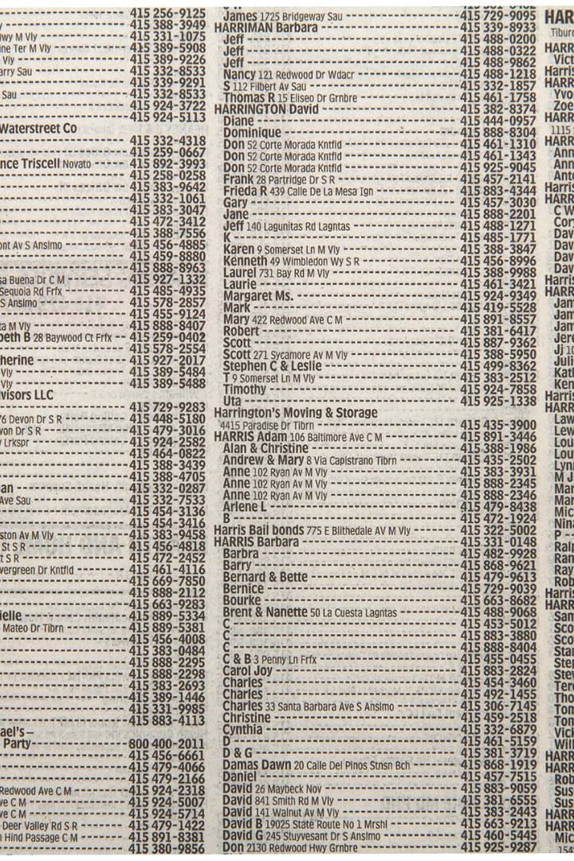
A DS Project of Phone Directory Using Doubly Linked List Data Structure
Follow along with our exploration of how doubly linked lists can be used to create a functional phone directory application.

Slide 3

Overview of Doubly Linked List Data Structure
Definition
Advantages
Real-life Examples
Doubly linked list is a type of linked list where each node contains a pointer to the previous and the next node.
Improved performance in list traversal, insertion, and deletion operations compared to other data structures.
Doubly linked lists are extensively used in computer systems, operating systems, and more.

Slide 4


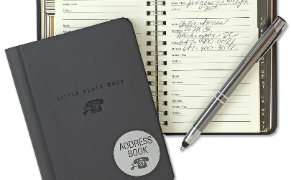
Functionality of Phone Directory Application
Features
Doubly Linked List Implementation
Integration with Address Book
Search for phone numbers, add and delete contacts
The linked list data structure is used to store and efficiently manage data in the phone directory system.
Integration with the system address book, allowing for seamless transfer of contacts and information.

Slide 5

Uses of Doubly Linked List
1
List Traversal
Efficient and fast traversal of elements in the linked list is possible due to pointer direction.
Insertions & Deletions
2
Doubly linked list facilitates faster and superior add and remove node operations.

Slide 6

Practical Applications of the Phone Directory
Personal Use
Business Use
Emergency Services
Organizing personal contacts and staying connected with loved ones.
Managing employee and client contact details, sales outreach, customer relationships, and more.
Providing quick access to emergency service phone numbers during a crisis.

Slide 7

Future Scope
1
Integration with Other Systems
2
Improved Search Functionality
3
Data Analytics
The phone directory system can be improved with analytical features to help identify trends and extract insights from user data.
The phone directory application can be integrated with other systems to streamline communication within a business or organization.
The current search feature can be enhanced with predictive search and filtering capabilities.

Slide 8


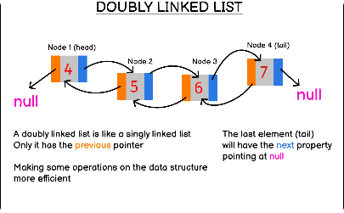

Conclusion
Impact of Phone Directory
The Role of Doubly Linked List
Special Thanks
We would like to thank our team members and mentors for their hard work, expertise, and cooperation in making this project a success.
The phone directory system can have a significant impact on individuals, businesses, and emergency services, and can improve efficiency and organization in daily life.
The implementation of doubly linked list data structure makes the phone directory application possible, enabling fast and reliable management of contact information.

Slide 9
THANK YOU

